Slide 1


TEAM NAME TEAM ID
ANISHA MORE CL2426
KARISHMA DALVI CL2426
ROHIT DOIJODE CL2426
THEME AND TRACK
Idea that show case the need of crop price prediction and traditions of cultivation
Gen AI

Slide 2
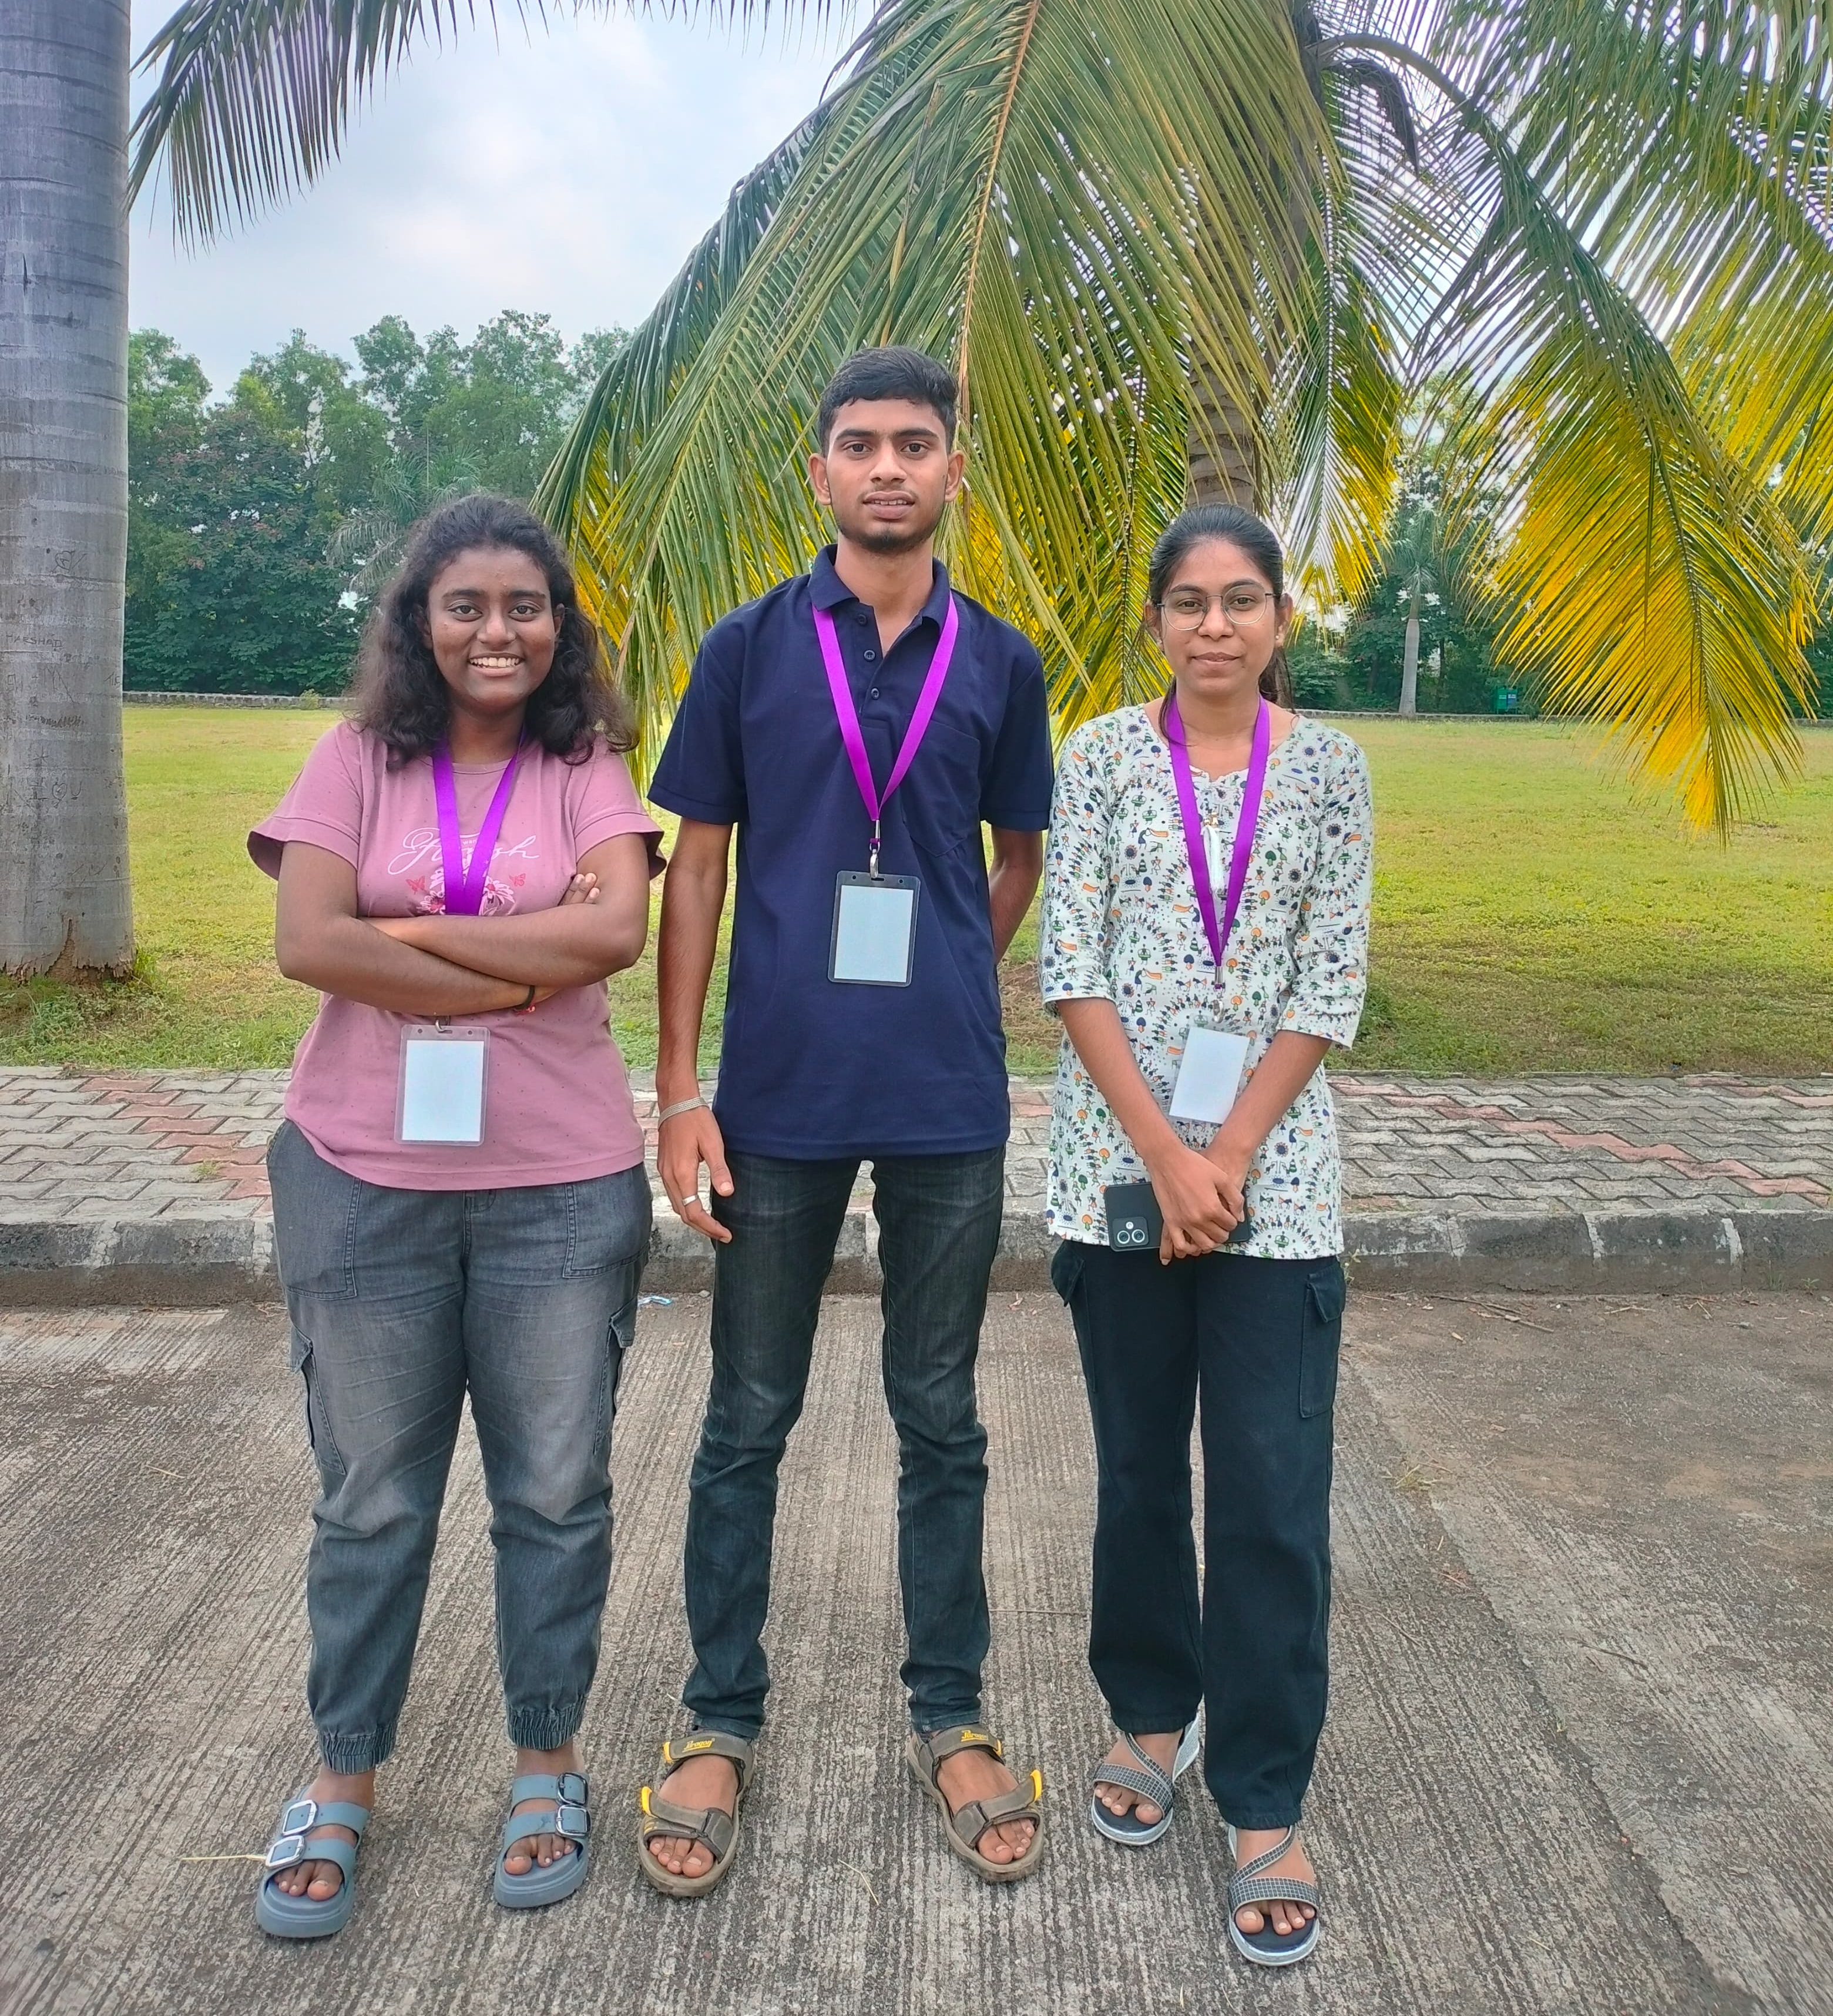
CODELITE 2024
ELECTROFIRE

Slide 3
OVERVIEW OF PRICE CROP PREDICTION
Crop Price Prediction: Uses historical data, market trends, and AI algorithms to forecast crop prices with high accuracy.
.Traditional Cultivation Practices: Offers detailed guides on crop-specific, region-based traditional cultivation methods.
Step-by-step instructions for preparing soil, planting, and harvesting using time-honored techniques.
Information on sustainable farming practices that help preserve soil quality and biodiversity.
Real-Time Market Analysis: Displays live demand and supply information for various crops. Provides comparative analysis of modern vs. traditional cultivation costs and yield outputs.
4. Weather and Climate Forecast Integration: Weather forecast tools to optimize planting and harvesting schedules. Early warnings for weather conditions that might affect crop yields or quality.

Slide 4
PROBLEM
GENERATED MARKET PRICE PREDICTION FOR CROPS

Slide 5
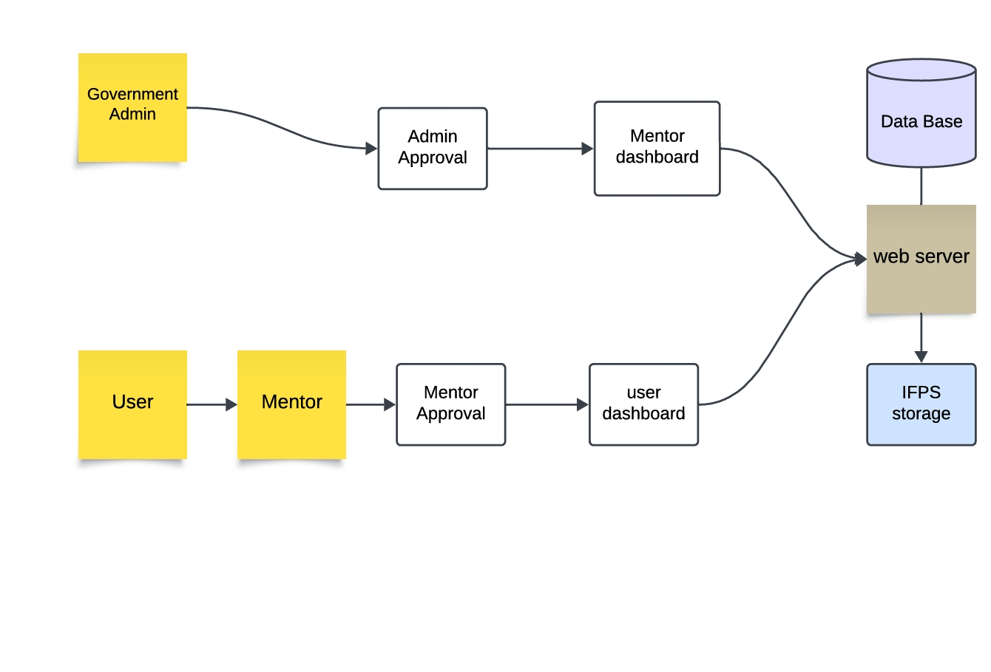
SOLUTION

Slide 6
VIDEO RECORDING OF IMPLEMENTATION
LINK -
pricing crops | Gen AI | Price Prediction For Crops |

Slide 7
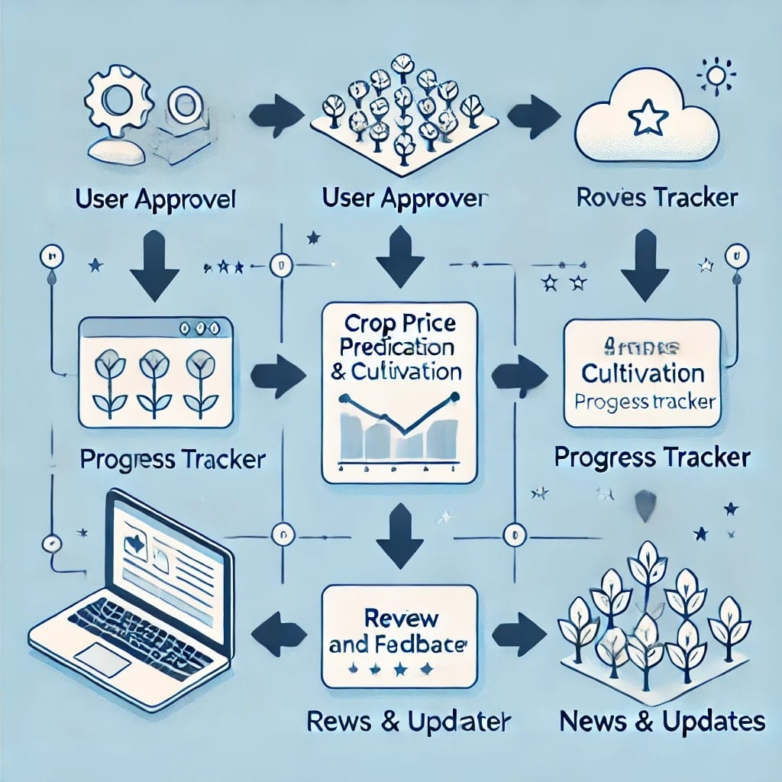
TECHNICAL EXECUTION
Data Collection
We collected historical crop price data from various sources, including government agencies, commodity exchanges, and agricultural news websites.
Data Cleaning and Preprocessing
We cleaned and preprocessed the data to handle missing values, outliers, and inconsistent units, ensuring data quality and consistency.
Feature Engineering
We engineered relevant features from the raw data, including seasonality, weather patterns, and economic indicators, to improve model accuracy.
Deployment and Monitoring
We deployed the trained model on a cloud platform to provide real-time crop price predictions, and continuously monitored its performance to ensure reliability.

Slide 8


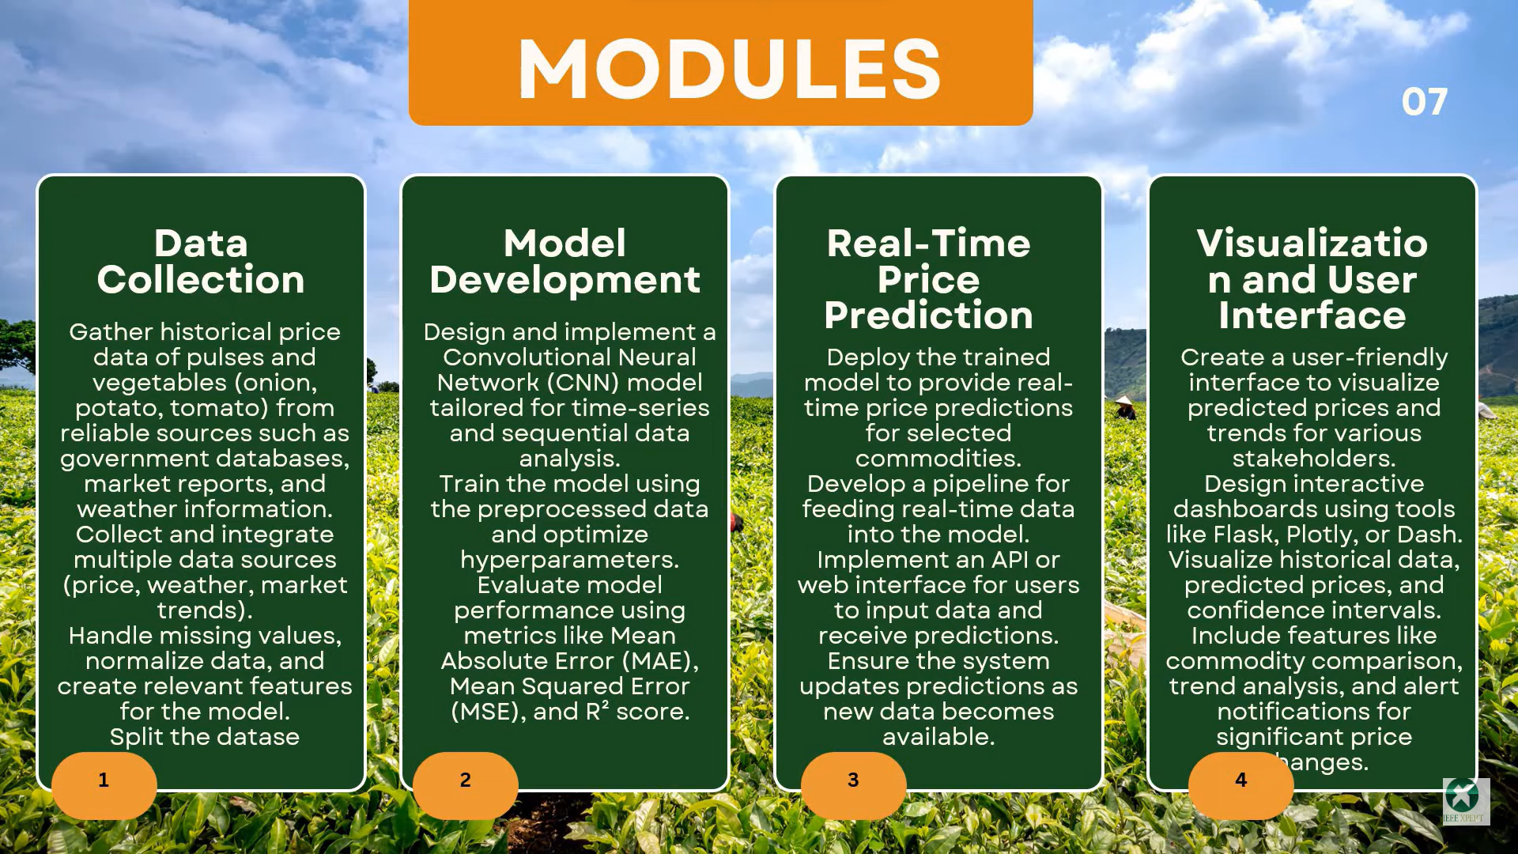
INNOVATION AND CREATIVITY

Slide 9
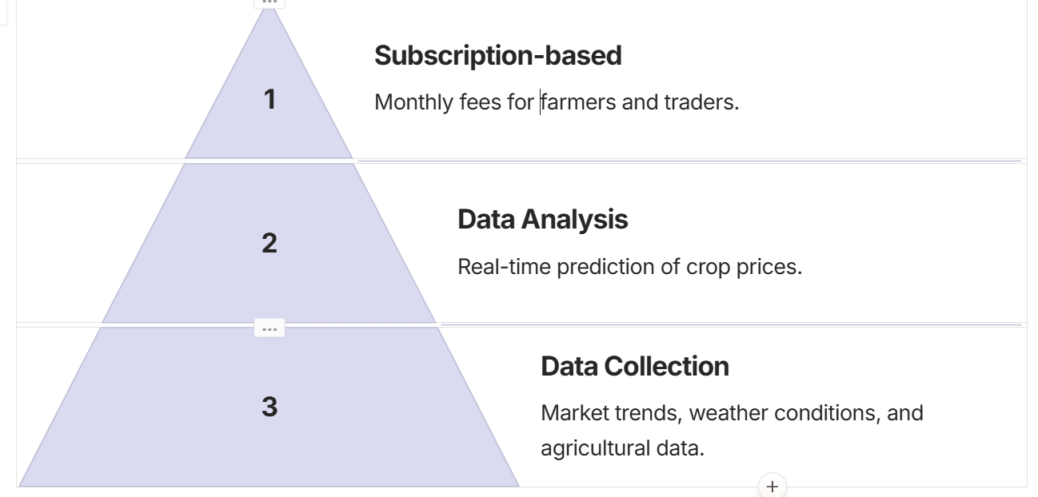
BUISNESS MODEL

Slide 10
FUTURE SCOPE
Advanced AI and Machine Learning
Blockchain for Supply Chain
IoT and Precision Agriculture
Climate Resilience
Global Expansion
Farm Automation
Mobile and E-commerce Integration

Slide 11
THANK YOU

